Slide 1
Cross-border projects & business valuations
Managing the complexities of international projects
Business valuation methods
Assets based valuations v. earnings based valuations
Using price-earnings (P/E) ratios to value listed companies
Adjusting the P/E ratio to value unlisted companies
Estimating free cash flows to use NPV methods
Information needs to value a target company (earnings method)
Link to module assessment – use exemplar assignment to see how EasyHotels was valued by the bidder, Ivanhoe

Slide 2

Business mergers & acquisitions
Cross-border issues:
Target company is located in another country from the bidder, e.g. Dow Chemicals merger with DuPont (US & European)
Exchange rate volatility
Different stock exchange rules
Country-based knowledge
Language barriers
Cultural differences

Slide 3

New product development (NPD)
Cross-border issues:
Customers are located in another country from the producer/supplier, e.g. Rolls Royce (UK) engines sold to aerospace co. Embraer (Brazil)
Trade tariffs
Shipping costs
Exchange rate volatility
Overseas consumer behaviour
Language translations (product names)

Slide 4

Buildings, bridges & facilities
Cross-border issues:
The structure spans 2 countries, e.g. channel tunnel (UK & France)
Government policies may differ
Clear division of responsibilities
Dual pricing policy/currency
Unified source of materials/labour
Language & Cultural differences

Slide 5

Events & social activities
Cross-border issues:
Overseas visitors to attend event, e.g. Formula 1 motor racing Grand Prix
Visa requirements in host country
Dual pricing policy/currency
International publicity/agents
Language & Cultural differences
Information for visitors, e.g. maps
Translation requirements

Slide 6
Rationales for acquisitions
Operational synergy
Economies of scale
Managerial synergy
Entry to new markets
Critical mass & market positioning
Quicker than internal growth
Asset stripping
See Watson & Head (core text for international corporate finance) p361-365

Slide 7
Problems with acquisitions
Paying too much for the target (causing share value of bidder to fall)
Bidding too little, risks an abortive takeover, very costly (both in financial and reputational terms)
Costs of financing a takeover – usually through share-for-share offer (issue costs of offer document, due diligence, extra audit fees)
Taking over target company liabilities, servicing debt. Etc.
Poor information on target company
Continuity of business operations and of key management personnel
Taxation problems, especially in cross-border deals
See Watson & Head, p.366

Slide 8
Peaks in takeover activity in the UK
1989 (1,337 valued at £27 billion)
2000 (587 valued at £107 billion)
2004 (741 valued at £31 billion)
2008 (558 valued at £36 billion)
2015 M&A boom in USA
2018 £78.8 billion peak in UK
2019 estimate £53.8 billion (£25.0 billion lower than 2018) 2020 lower
What drives the level of M&A activity?
See Watson & Head, pages 367-368.

Slide 9
Business valuation methods
Assets based
Balance sheet values at historic cost less depreciation not useful
Revaluation of property assets
Asset changes since last balance sheet (e.g. inventory levels)
Off-balance sheet assets (leases)
Goodwill (intangible assets)
Earnings based
Are reported earnings of target co. reliable (audit credibility)?
Will future earnings grow or decrease at the same rate as in the recent past?
Identification of suitable P/E ratio
Will the merger/acquisition affect turnover or margins in target co.?
How many years can you estimate cash flow for?

Slide 10
Using price-earnings (P/E) ratios to value target companies
P/E ratio = share price/earnings per share (published for listed cos)
Examples most as quoted in FT @ 30/09/20 or closest date:
Banks (typically 10 to 25, e.g. HSBC 24.48, RBS 25.13)
Food &Beverage (Diageo 43.54, Coca-cola 22.39, Unilever 24.79)
Media & Entertainment (industry ave. was 30.72 but falling)
Retail (Morrison 11.64 , Sainsbury 32.75, Tesco 20.74 )
Pharmaceuticals (AstraZeneca now 43.2 and rising)
Using actual P/E ratio x EPS = share price, x no. of shares = market capitalisation
Question for bidders – is the market pricing reliable? If the target is taken over what might happen to (a) the target’s EPS, (b) the bidder’s share price?

Slide 11
What if the target company is not listed?
You can apply an industry average P/E ratio to the target’s EPS, but less a % discount for the lack of marketability and market knowledge, but how much would you discount it by?
Anywhere from 20% to 40% may be applied, depending on the quality of reported earnings
In most cases target companies would be valued at least 3 ways (assets-based, P/E based and DCF based), especially if unlisted
See Watson & Head, p.369-377.

Slide 12
Example Valuation of Hulse plc Watson & Head, p370-377
Stock market value with: £million
Target’s P/E. EPS 18.4p x PE 13.59 = £2.50 x 246m shares = 615
Bidder P/E. EPS 18.4p x PE 18.2 = £3.35 x 246m shares = 824
Weighted ave. P/E. EPS 18.4p x 16.93 = £3.11 x 246m shares = 767
Sector ave. P/E. EPS 18.4p x 15.5 = £2.85 x 246m shares = 702
DCF based value:
Est. cash flow £38m with 4% growth & 7% bidder’s WACC
(£38m x 1.04)/(.07-.04) = 1,317*
Or at sector ave. WACC (£38m x 1.04)/(.09-.04) = 790*
* excluding sale of assets for £60m in 2 years’ time

Slide 13
What value would you base your offer on?
More than £615 or the bid would be dead in the water
Not as much as £1.3 billion (the highest valuation)
Maybe somewhere between £702m and £790m
(2 values using sector ave.)
Outcome maybe around £800m, but could well be 20% higher, £960

Slide 14
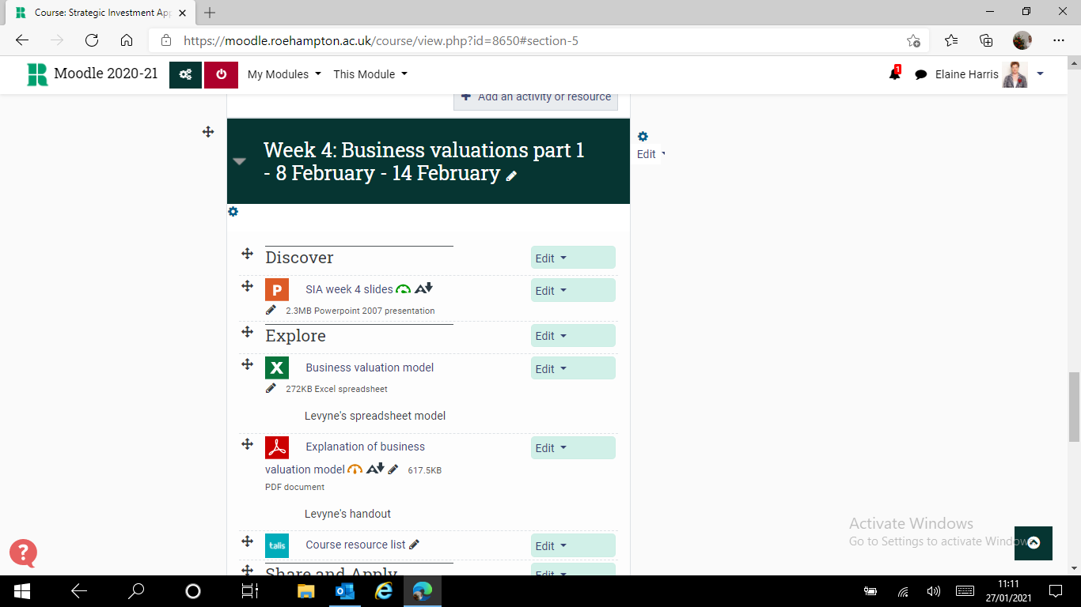
Where to find the spreadsheet model to explore & apply in the seminar

Slide 15

Recap: Information needed to appraise a takeover
Estimate of annual earnings:
Future cash flow plus growth
What is a realistic timescale over which to appraise a takeover (a fixed period or DCF to infinity)?
Estimate of the cost of capital (to use as a discount rate)
Find the present value of the future earnings stream (this is theoretically the maximum price you would offer)
Factor in any synergies/economies of scale
Strategic and risk analysis – don’t forget other factors

